Slide 1
AGENDA
BW: THINK PAIR SHARE
SUMMATIVE OVERVIEW
RAFT COLONIES NOTES

Slide 2
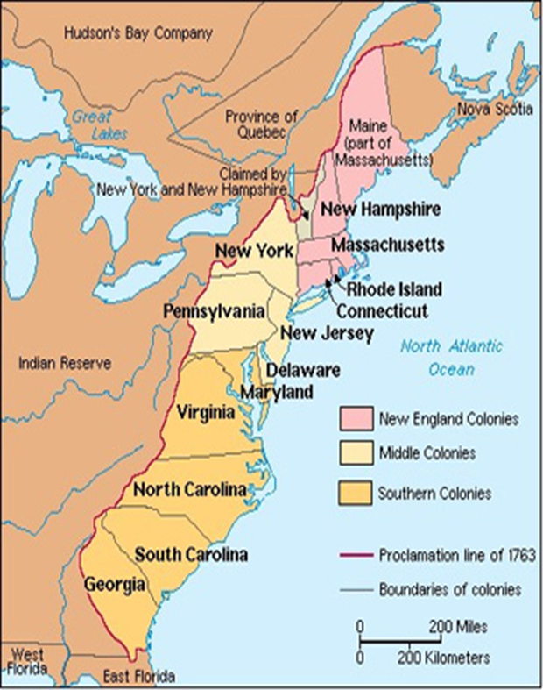

Slide 3
Why did people come to the colonies?
POLITICAL
To escape persecution from the monarchy
Self-government

Slide 4
Why did people come to the colonies?
ECONOMIC
To escape debt in England
Economic opportunity
Availability of land
Profit from trade and profit
Search for gold

Slide 5
Why did people come to the colonies?
RELIGIOUS
Escape religious persecution
To leave the Church of England
More religious freedom
Missionaries

Slide 6
NEW ENGLAND:
MA, RI, CT, NH
GEOGRAPHY
Rocky Soil that is bad for farming
Cold Winters
Short growing season
Forests, rivers
Natural harbors

Slide 7
NEW ENGLAND:
MA, RI, CT, NH
ECONOMY
Small farms
Fishing
Fur trade
Shipbuilding
Lumber
Trade

Slide 8
NEW ENGLAND:
MA, RI, CT, NH
RELIGION
Puritans (Protestant Christians)
Puritans did not believe in religious tolerance
Rhode Island - Judaism

Slide 9
NEW ENGLAND:
MA, RI, CT, NH
MISC. (Write this in the box that says New England)
Mayflower Compact – Plymouth, MA

Slide 10
MIDDLE COLONIES: NY, NJ, PA, DE
GEOGRAPHY
Longer growing season
Fertile soil
Rivers
Natural Harbors

Slide 11
MIDDLE COLONIES: NY, NJ, PA, DE
ECONOMY
Some cash crops
Export wheat and corn
Fur trade
Trade

Slide 12
MIDDLE COLONIES: NY, NJ, PA, DE
RELIGION
Quaker – Pennsylvania
Religious tolerance

Slide 13
MIDDLE COLONIES: NY, NJ, PA, DE
MISC. (Write this in the box that says Middle Colonies)
Diverse population – Many different religions and nationalities

Slide 14
SOUTHERN COLONIES:
VA, MD, NC, SC, GA
GEOGRAPHY
Long growing season
Fertile soil

Slide 15
SOUTHERN COLONIES:
VA, MD, NC, SC, GA
ECONOMY
Slave labor
Much agriculture (farming)
Large plantations
Cash crops: Rice, Tobacco

Slide 16
SOUTHERN COLONIES:
VA, MD, NC, SC, GA
RELIGION
Catholics – Maryland
Religious tolerance

